Slide 1
A single axis ball balancing platform
Akinola Abdullateef Cohort 20 Second Semester Project

Slide 2
Problem statement
Engineering systems increasingly require reliable, real-time control to maintain desired operating conditions; however, achieving precise ball positioning on a platform presents a control challenge due to the ball's continuous movement in response to changes in platform inclination. This project investigates a minimal, single-axis ball-balancing system that uses feedback control to maintain the ball at a specified setpoint.

Slide 3
Aim and objective
Aim
To design and implement a single-axis ball-balancing platform using PID control to maintain a ball at a desired setpoint.
Objectives
To design and fabricate a single-axis ball-balancing platform.
To integrate a position sensor for real-time ball position measurement.
To implement a PID controller for regulating the ball's position.
To interface a servo motor with the control system to adjust the platform's inclination.
To evaluate the system's performance in terms of stability, response time, and positioning accuracy.

Slide 4
Main Components
Platform
Ball
Servo Motor
Position Sensor (Ultrasonic Sensor)
Arduino uno
Power supply
Connecting mechanism

Slide 5
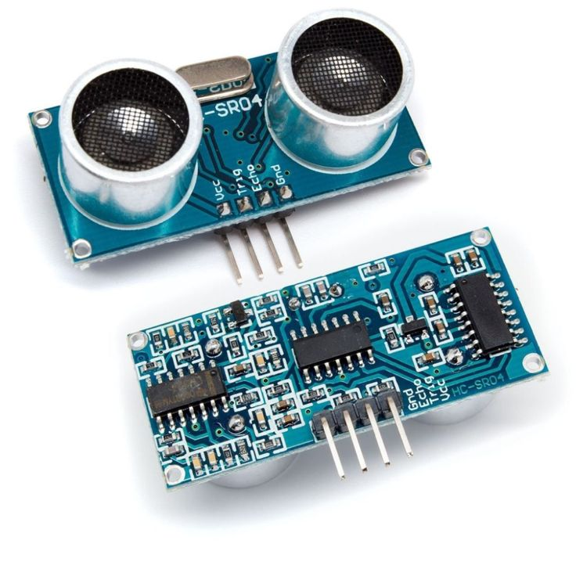
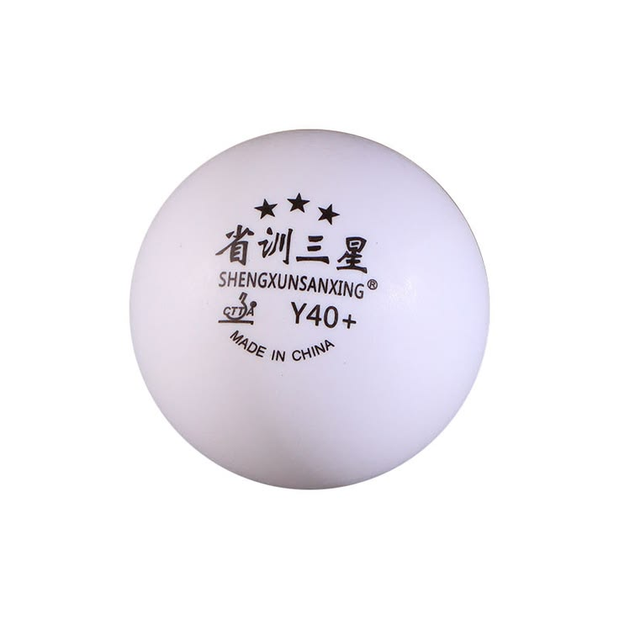
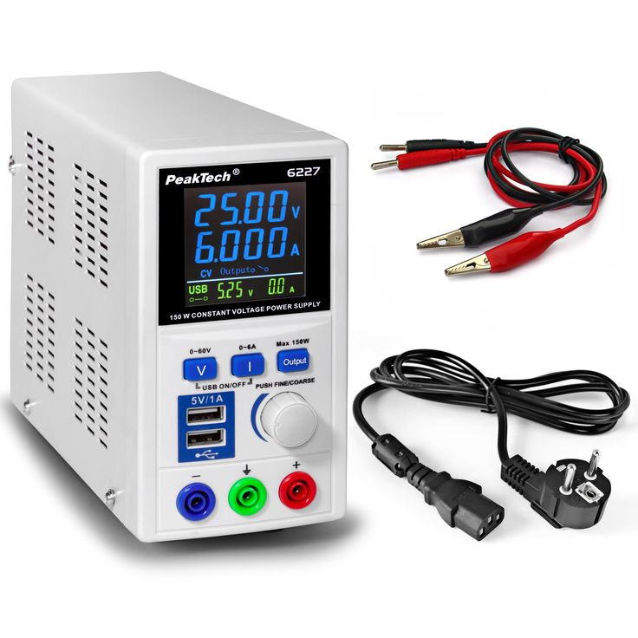
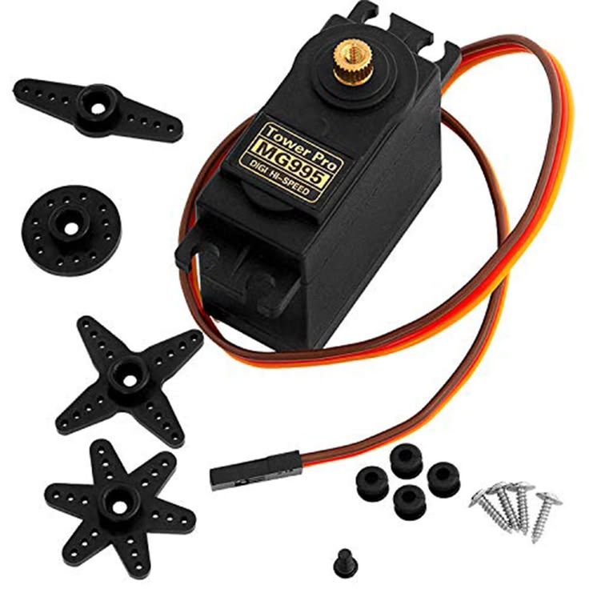
Main component’s pictures
Position Sensor
Ball
Servo Motor
Power Supply

Slide 6
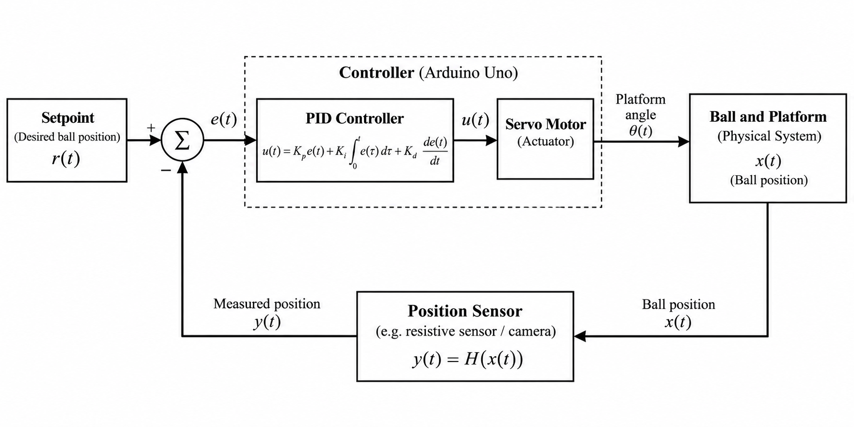
System Architecture

Slide 7

Mechanical Design (Connecting Mechanism)

Slide 8
Applications
1. Robotics and Automated Systems.
2. Precision Manufacturing and Material Handling.
3. Control Systems Education and Research.
4. Active Vibration and Motion Control.

Slide 9
Thank YOU

